Slide 1
A
Stock Talk

Slide 2
A
Requirements
User should be able to search a given stock by symbol, and get its details
Adaptive autosuggest - suggestions get hydrated and specific as the user types
Click Item/Search/Enter – Show stock details
Name and Symbol of Company
Description
Current Price
Change its traded on
Industry
PE Ratio
Market Cap
Stock Price chart
Multiple searches and navigating through them.
Data refresh in a configurable time interval

Slide 3
A
App Design
User should be able to search a given stock by symbol, and get its details
Adaptive autosuggest - suggestions get hydrated and specific as the user types
Click Item/Search/Enter – Show stock details
Name and Symbol of Company
Description
Current Price
Change its traded on
Industry
PE Ratio
Market Cap
Stock Price chart
Multiple searches and navigating through them.
Data refresh in a configurable time interval

Slide 4
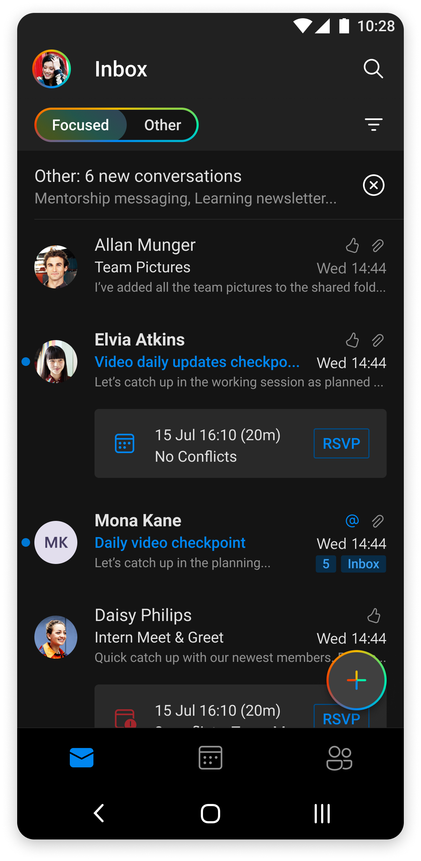
A
App Flow
Main Screens
Search Screen
Stock Details
Stock Timeline ( sub of Stock Details )

Slide 5
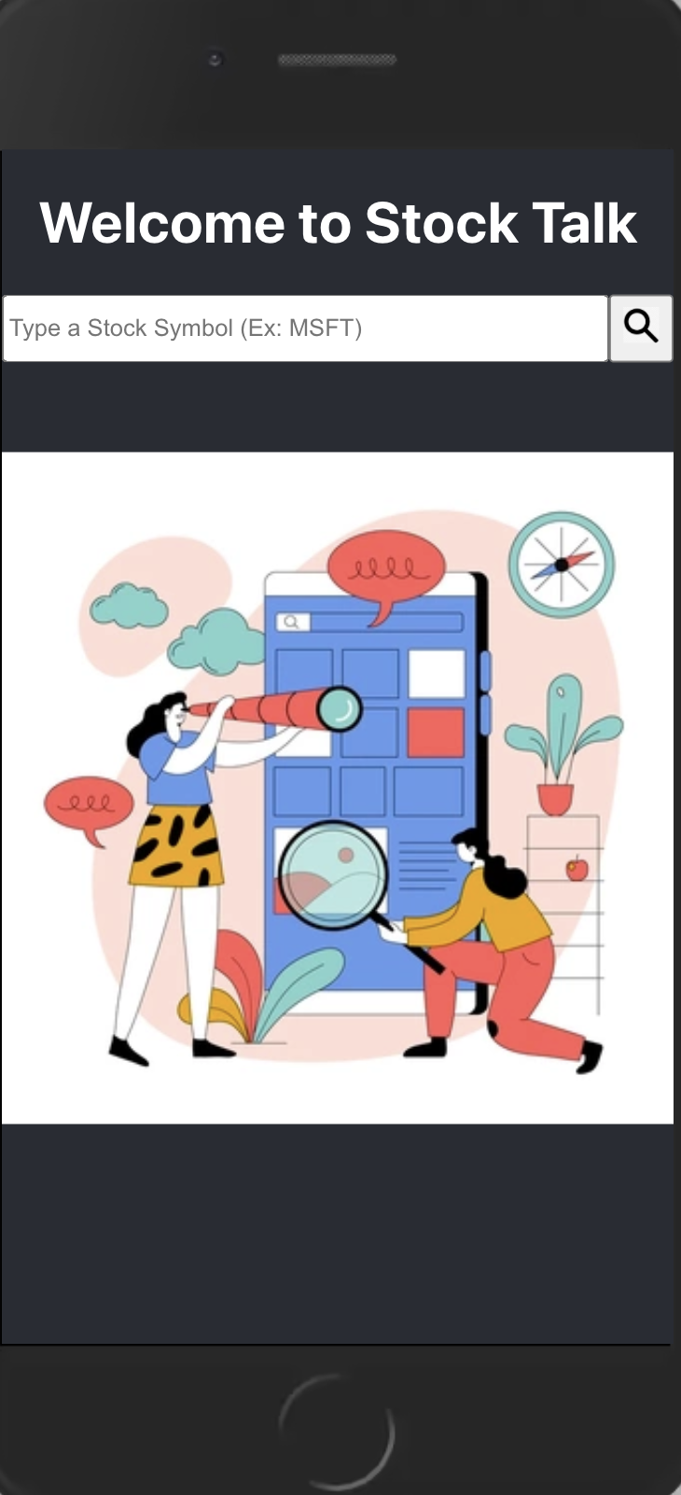
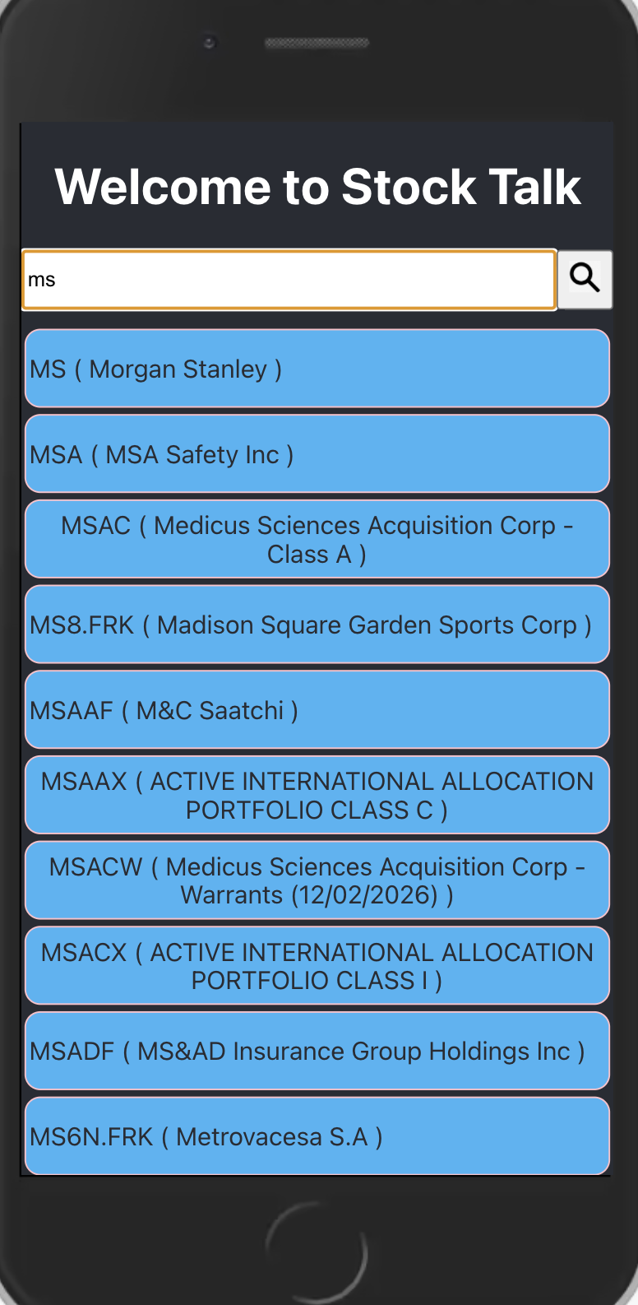
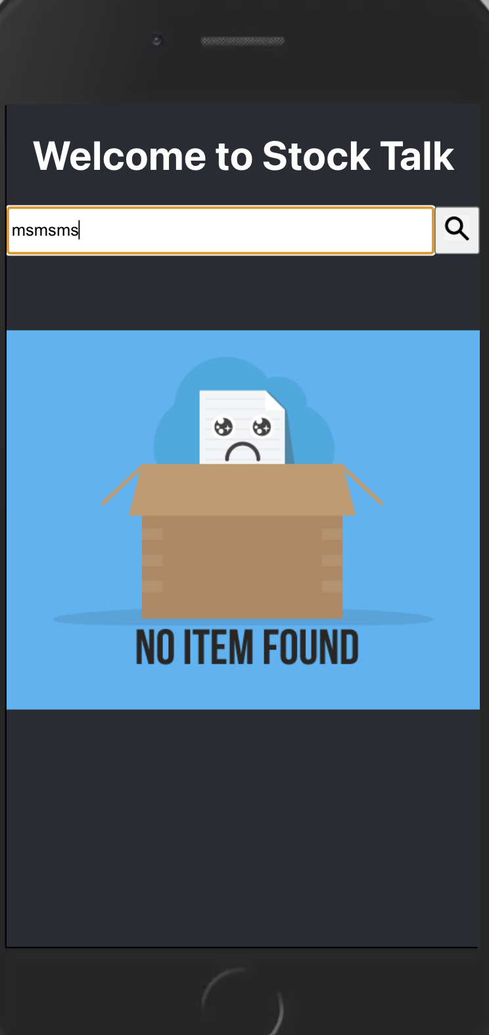
A
Screens - Search
Empty Query
Valid Query
No Results

Slide 6
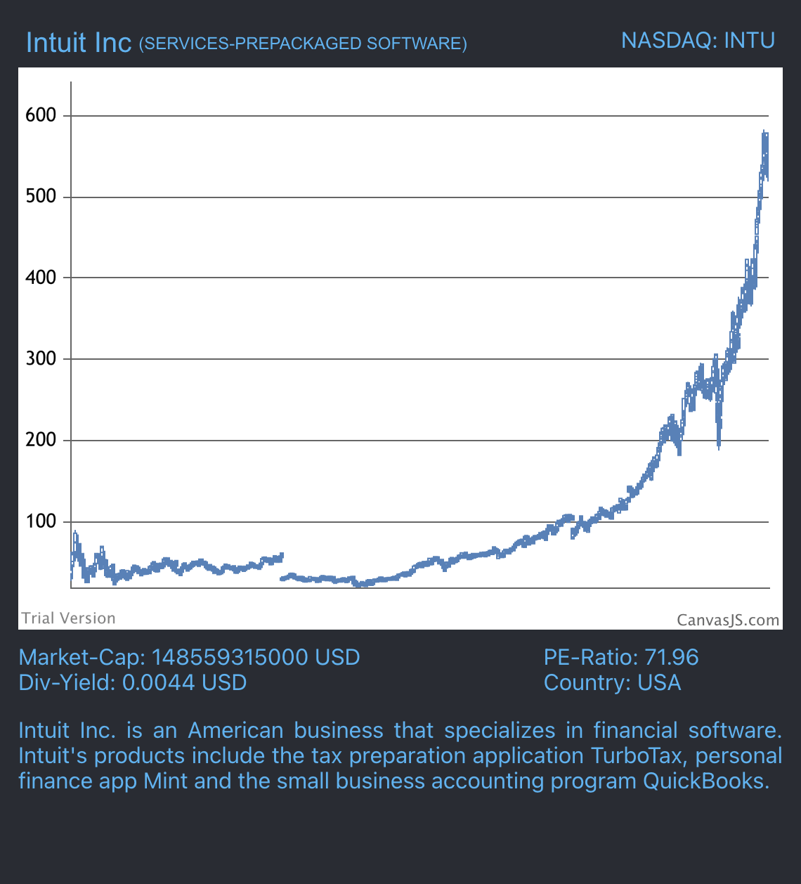
A
Screens - Details
Name of Company
Symbol
Industry
Exchange
Vitals
Market Cap
PE Ratio
Div Yield
Country
Description
Trends

Slide 7
A
Demo

